Slide 1



Amazon Sales Analysis
Bhavana Balasa
S9322

Slide 2
Business
Problem
The project aims to gain insight into Amazon's sales data to understand the factors affecting sales in different branches.

Slide 3
Data Understanding
Dataset contains sales transactions of three different branches of Amazon, respectively located in Mandalay, Yangon and Naypyitaw with 17 columns and 1000 rows.

Slide 4
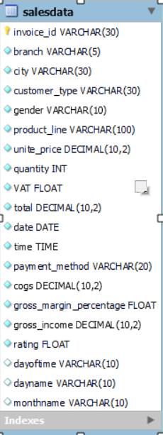
ER Diagram:

Slide 5
Exploratory Data Analysis
Exploratory Data Analysis (EDA) for Amazon sales data involves understanding the data and framework to answer each business question listed.

Slide 6
There are 6 distinct product categories
The food and beverages category has the highest sales with 56144.96(17.38%).
Health and beauty sales are low compared to others.
The remaining product sales are also up to the mark.
More products are sold from branch A.
Product categories associated with females are Fashion accessories and males with Health and beauty.
The average rating for food and beverages is 7.1 and Health and Beauty, and Fashion Accessories is 7.
Product
Analysis

Slide 7
Sales
Analysis
Sales have noticed a down from January to February by 3% and March sales are good.
Revenue generated by Naypyitaw city is higher than that of others, at 34%.
Cost of goods was recorded as high in January.
On the weekday Saturdays, evening time observed the high sales.
The Branch C performance is high by 34%.

Slide 8
Customer
Analysis
There are Normal and member customers.
Most of the sales are from Member customers.
Female customers are predominant in sales.
Ewallet and cash is the most used payment mode.

Slide 9
Branch
Analysis
Among the three branches branch C’s revenue performance is high by 34% and branches A and B by 33%.
More products are sold from branch A.
The Naypyitaw city had 34% highest VAT.
Male customers are more in branches A and B, but females are more in branch C.
The average rating from branches A and C is 7, and branch B is 6.8.

Slide 10
Focus on promoting Health and Beauty products to increase their sales and ratings.
Leverage Branch C's strong performance to replicate successful strategies in other branches.
Increase engagement with Normal customers to convert them into members and boost overall sales.
Optimize inventory and cost management during January, as COGS tends to be higher in this month.
Consider expanding marketing campaigns targeting Saturday evenings to capitalize on peak sales times.
Analyze why Branch B lags in performance and ratings, and implement corrective measures.
Actionable Insights

Slide 11
Thank
You

